Slide 1

Bases de Dados - Dorlux
Checkpoint 1/2 - Group 11

Slide 2

Presentation Structure
System Contextualization
Requirements
Conceptual Model
Logic Model
Bases de Dados – Dorlux | Checkpoint 1/2 - Group 11

Slide 3
1- System Contextualization
What's Dorlux?
Motivations and Objectives
Viability of the process
Resources needed
Execution plan
Bases de Dados – Dorlux | Checkpoint 1/2 - Group 11

Slide 4
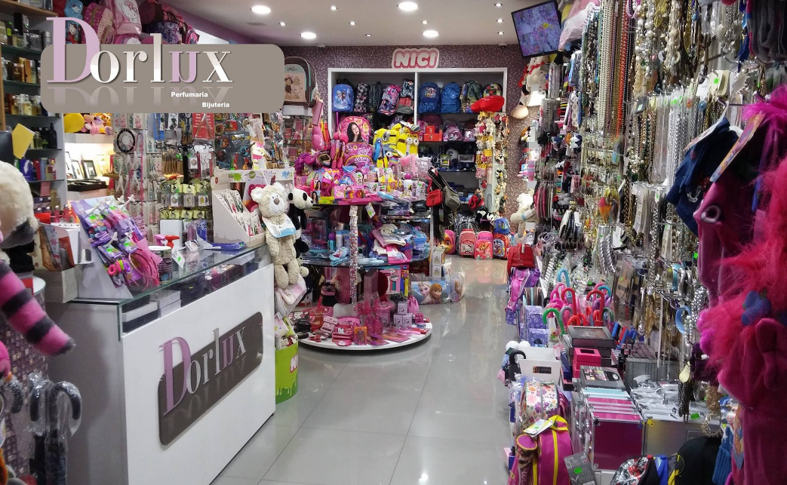
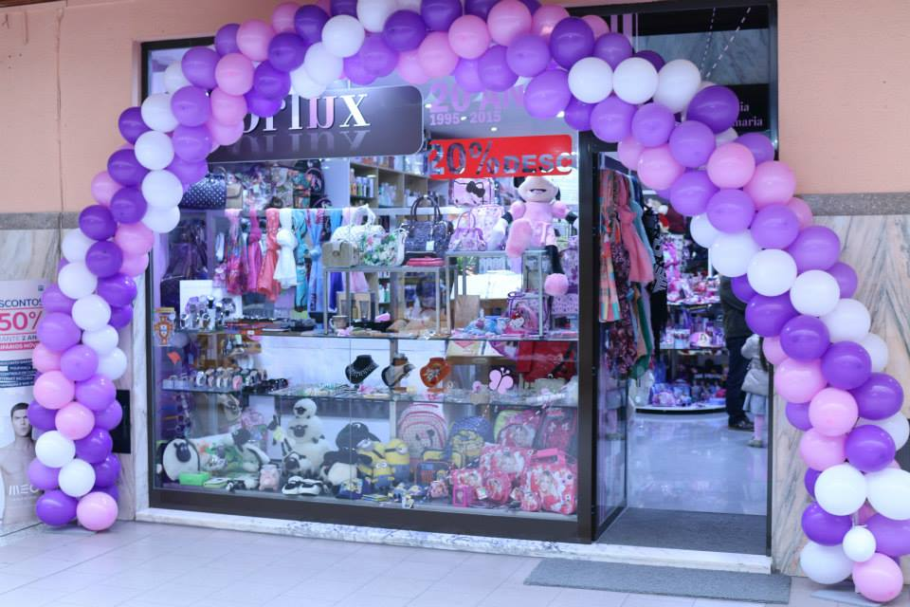
What's Dorlux?
Dorlux is a gift shop located in a small mall at Vila das Taipas, Guimarães. It was created in 1996 by Mrs. Dores as a way to start an independent business.
Bases de Dados – Dorlux | Checkpoint 1/2 - Group 11

Slide 5
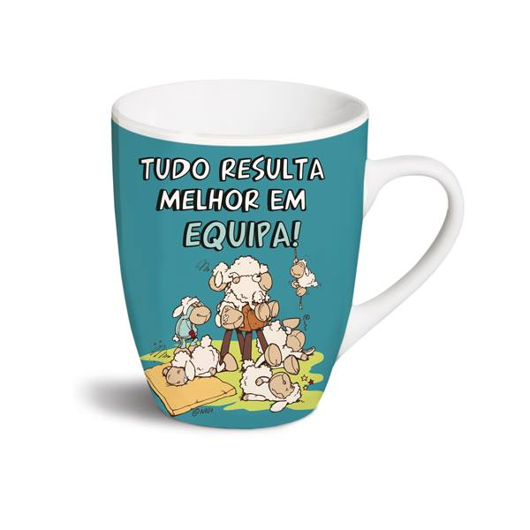
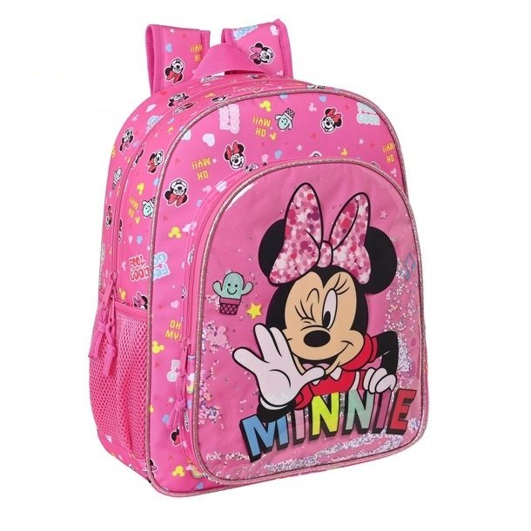
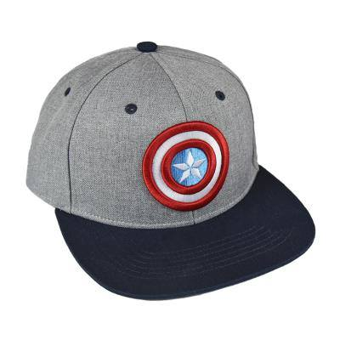
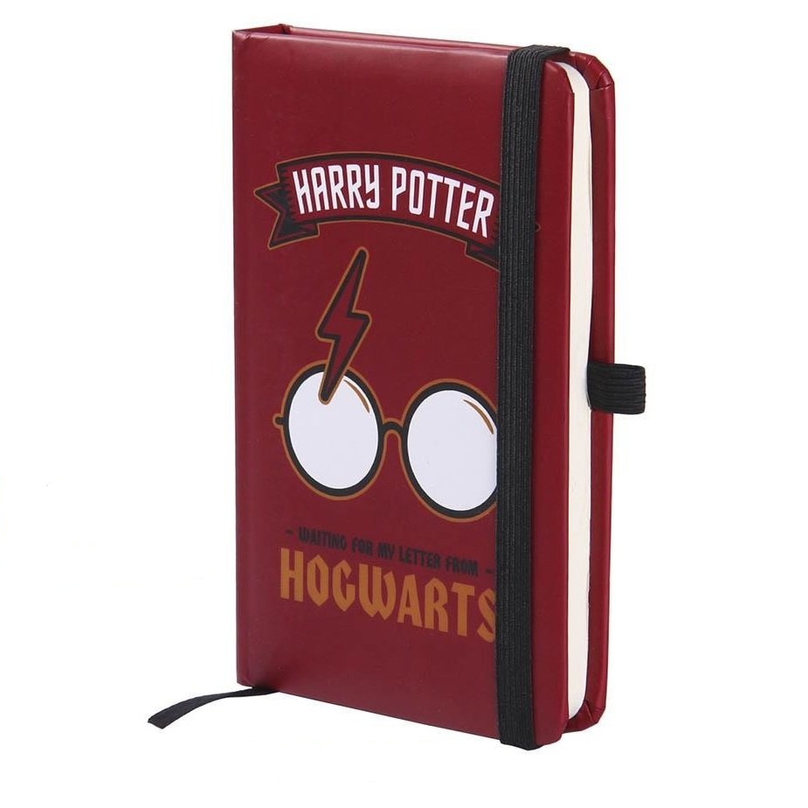
What's Dorlux?
These are some items that Mrs. Dores sell at Dorlux.
Bases de Dados – Dorlux | Checkpoint 1/2 - Group 11

Slide 6
Motivation and Objectives
A few months ago Mrs. Dores found out that she was ill and because of that Dorlux had the necessity to become an online business so that Mrs. Dores could work remotely and, at the same time, take care of her health.
That's where the database comes in.
Bases de Dados – Dorlux | Checkpoint 1/2 - Group 11

Slide 7
Motivation and Objectives
Have a solid online store so that she can keep and gain clients
Manage and track orders
Control and improve the quality of the products
Stock control
Management of store accounts
Profiling
Bases de Dados – Dorlux | Checkpoint 1/2 - Group 11

Slide 8
Viability of the process
This project consists on the implementation of a database that allows relation data with home delivery service at Mrs. Dores future online store so that she can manage everything easier. This would also help Mrs. Dores to manage stock and know when to order products from suppliers.
Bases de Dados – Dorlux | Checkpoint 1/2 - Group 11

Slide 9
Resources needed
Human
- Person that works on the store
- Clients
- Development team
Material
- Hardware (1 server, 4 computers, internet access)
- Software (DBMS, billing program already implemented)
Bases de Dados – Dorlux | Checkpoint 1/2 - Group 11

Slide 10
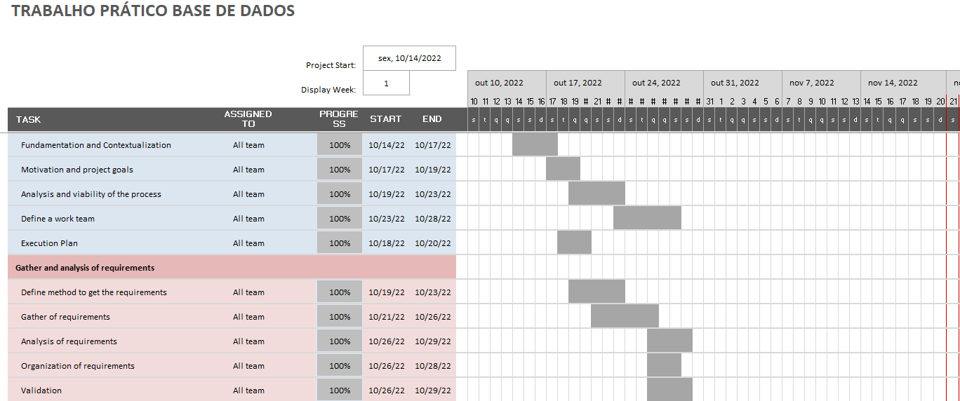
Execution plan
Bases de Dados – Dorlux | Checkpoint 1/2 - Group 11

Slide 11
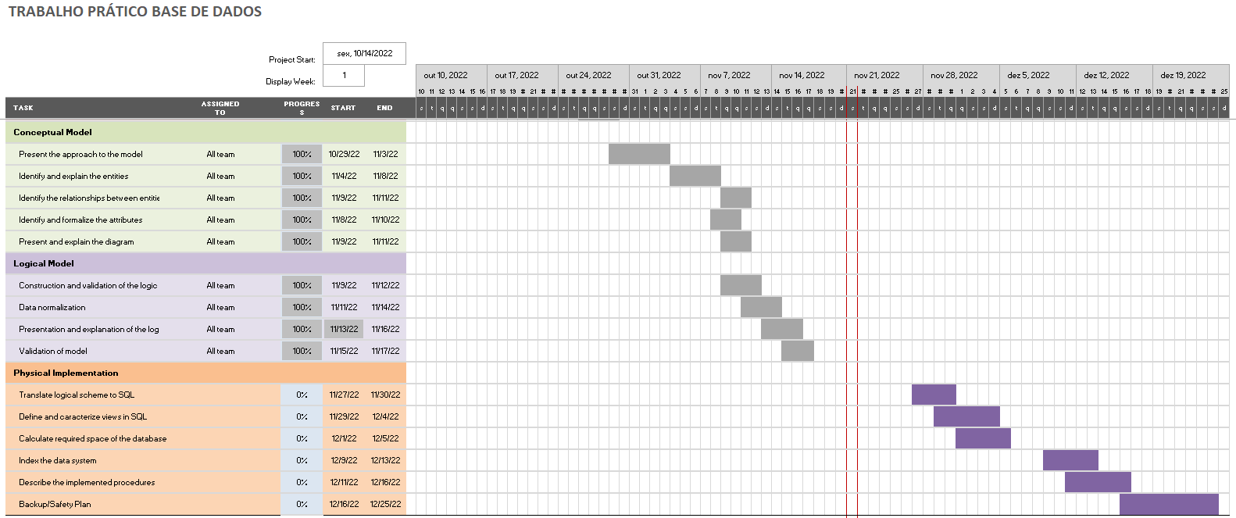
Execution plan
Bases de Dados – Dorlux | Checkpoint 1/2 - Group 11

Slide 12
2- Requirements
Requirements survey and analysis method
Types of requirements
Analysis and general validation of requirements
Bases de Dados – Dorlux | Checkpoint 1/2 - Group 11

Slide 13
Requirements survey and analysis method
For the gathering of requirements we used the interview method. We interviewed Dona Dores, her family and some clients.
Bases de Dados – Dorlux | Checkpoint 1/2 - Group 11

Slide 14
Types of requirements
Description
Control
Manipulation
Bases de Dados – Dorlux | Checkpoint 1/2 - Group 11

Slide 15
Description requirements
A customer record must contain a unique identifier (number) and optionally fill in the taxpayer number
A customer's address contains a unique identifier, postal code and city
A contact is identified by a code, also having the name, mobile phone number and email
Each employee has a unique identifier, a contact with a unique identifier and also a manager (identified by his unique code). Optionally a salary
A supplier has a mandatory VAT number which will be its unique identifier
Each item has a unique identifier a name, a purchase price, a sale price and stock, optionally it has a description of the item (size, weight, color, etc..) and the category it belongs to by its identifier
Bases de Dados – Dorlux | Checkpoint 1/2 - Group 11

Slide 16
Description requirements
A category is identified by a key, the name of the category itself, a mandatory tax rate and an optional description of the category
For a sale to take place, the system must know the customer's number, the employee who processed the sale, the contact of each one, all of this identified by their unique key, status (Done, Pending, Waiting, Error), date of order, date the order was last updated and, if applicable, the price for shipping the order
Bases de Dados – Dorlux | Checkpoint 1/2 - Group 11

Slide 17
Manipulation requirements
Organization of the business model
Product quality control
Stock control
Control of suppliers (purchase price, product quality, etc.)
Management of store accounts (tax rate, shipping rate, sales, profits, etc)
Customer customization, knowing their tastes through past purchases (profiling)
Establishment of personalized customer discounts
Quality control of orders, namely with regard to shipping time
Indication of the status of the order, allowing the customer to know where he is in the shipping process
Knowledge of the products sold, so that it is possible to estimate with more/less output
Improve the store's service quality
Bases de Dados – Dorlux | Checkpoint 1/2 - Group 11

Slide 18
Control requirements
Each customer places a certain number of orders and each order has only one associated customer
An order has several items (amount attribute tells us the number of items in the order) and the same item can be present in several orders
An item can have multiple suppliers and the same supplier can supply multiple items
A supplier has only one contact (e-mail, mobile phone, name) and this contact is unique, that is, it is only present for that supplier
A customer has only one contact (e-mail, mobile phone, name) and this contact is unique, that is, it is only present for that customer
An employee has only one contact (e-mail, cell phone, name) and this contact is unique, that is, it is only present for that employee
Bases de Dados – Dorlux | Checkpoint 1/2 - Group 11

Slide 19
Control requirements
A customer can have several addresses and the same address can be associated with several customers.
An order has only one associated employee, however, the same employee can have several orders associated with it.
An item has a certain type associated with it. The same type can cover several items.
A manager can have several employees, however, an employee only has one manager.
Bases de Dados – Dorlux | Checkpoint 1/2 - Group 11

Slide 20
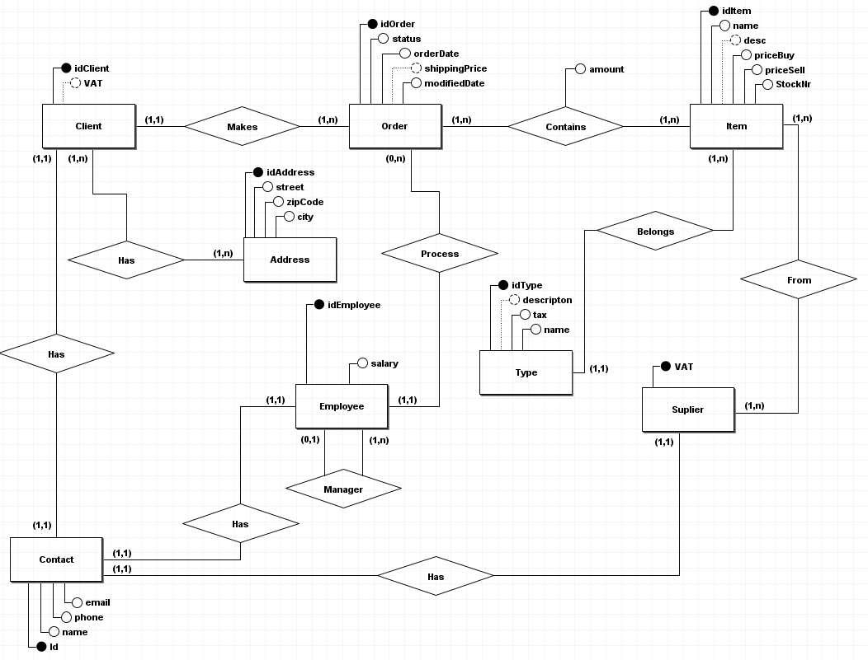
3- Conceptual Model
Bases de Dados – Dorlux | Checkpoint 1/2 - Group 11

Slide 21
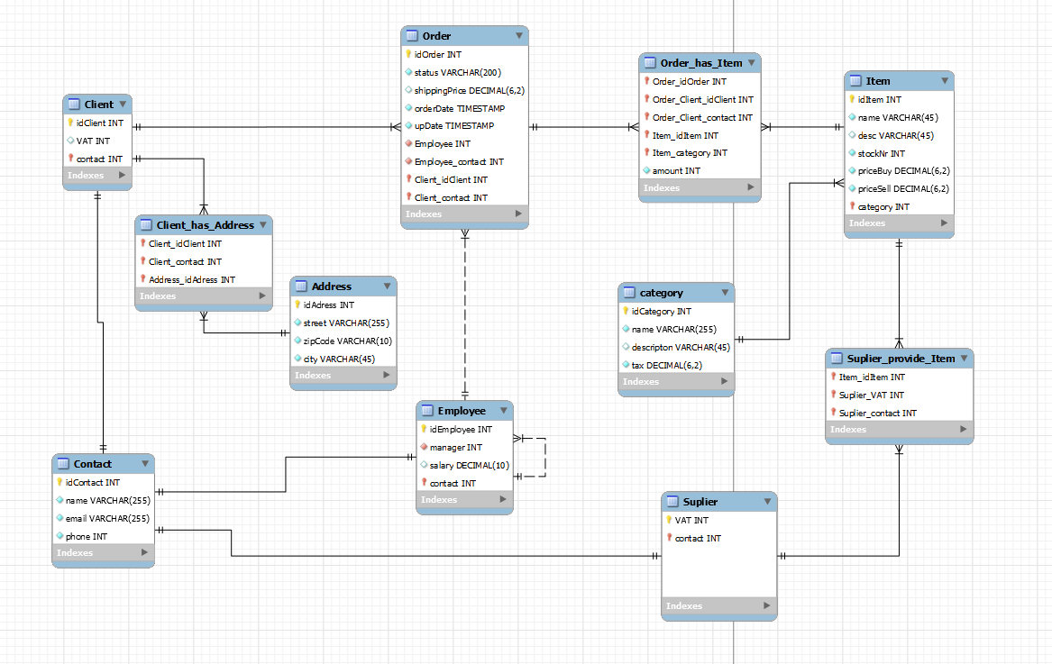
4- Logic Model
Bases de Dados – Dorlux | Checkpoint 1/2 - Group 11

